Slide 1

LJMU MSc DS/ML C28

Slide 2


Course: MSDS/ML
Live Session On: Revision Reinforcement Learning & Explainable AI
Instructor: Dr. Jyoti Dabass

Slide 3

Welcome & Context
Notes:
Note to SMEs: Start the session with a recall of the concepts taught in core content would help build a connection between the two
For example, if teaching a session on e-skills, asking the learners what they understood from the first module or the core concepts that were taught in module

Slide 4
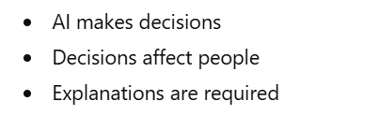
Why This Session Matters
Notes:
Note to SMEs: Start the session with a recall of the concepts taught in core content would help build a connection between the two
For example, if teaching a session on e-skills, asking the learners what they understood from the first module or the core concepts that were taught in module

Slide 5

A Simple Question
Notes:
Note to SMEs: Start the session with a recall of the concepts taught in core content would help build a connection between the two
For example, if teaching a session on e-skills, asking the learners what they understood from the first module or the core concepts that were taught in module

Slide 6
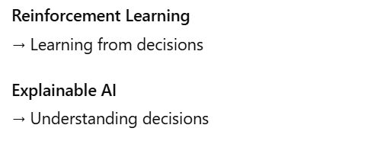
Where Reinforcement Learning Meets Explainable AI
Notes:
Note to SMEs: Start the session with a recall of the concepts taught in core content would help build a connection between the two
For example, if teaching a session on e-skills, asking the learners what they understood from the first module or the core concepts that were taught in module

Slide 7
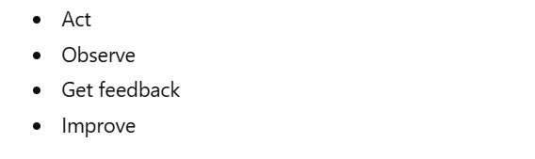
Reinforcement Learning (Simplest View)
Notes:
Note to SMEs: Start the session with a recall of the concepts taught in core content would help build a connection between the two
For example, if teaching a session on e-skills, asking the learners what they understood from the first module or the core concepts that were taught in module

Slide 8

Corporate Example
Notes:
Note to SMEs: Start the session with a recall of the concepts taught in core content would help build a connection between the two
For example, if teaching a session on e-skills, asking the learners what they understood from the first module or the core concepts that were taught in module

Slide 9

Reinforcement Learning in One Loop
Notes:
Note to SMEs: Start the session with a recall of the concepts taught in core content would help build a connection between the two
For example, if teaching a session on e-skills, asking the learners what they understood from the first module or the core concepts that were taught in module

Slide 10
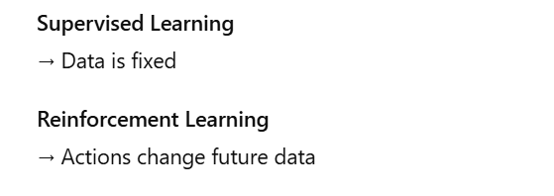
Key Difference from Other AI
Notes:
Note to SMEs: Start the session with a recall of the concepts taught in core content would help build a connection between the two
For example, if teaching a session on e-skills, asking the learners what they understood from the first module or the core concepts that were taught in module

Slide 11
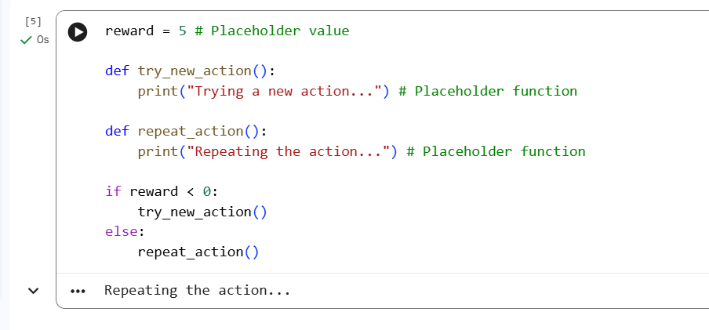
Learning From Feedback (GitHub)
)
Notes:
Note to SMEs: Start the session with a recall of the concepts taught in core content would help build a connection between the two
For example, if teaching a session on e-skills, asking the learners what they understood from the first module or the core concepts that were taught in module

Slide 12
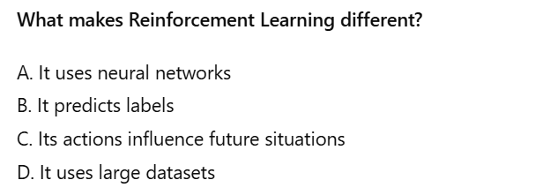
Quick Engagement Check (MCQ)1
Notes:
Note to SMEs: Start the session with a recall of the concepts taught in core content would help build a connection between the two
For example, if teaching a session on e-skills, asking the learners what they understood from the first module or the core concepts that were taught in module

Slide 13
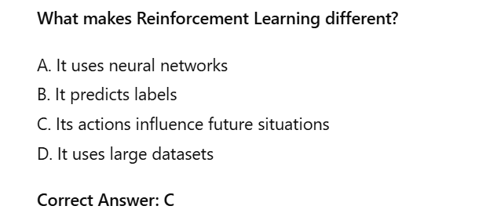
Quick Engagement Check (MCQ)1 Answer
Notes:
Note to SMEs: Start the session with a recall of the concepts taught in core content would help build a connection between the two
For example, if teaching a session on e-skills, asking the learners what they understood from the first module or the core concepts that were taught in module

Slide 14
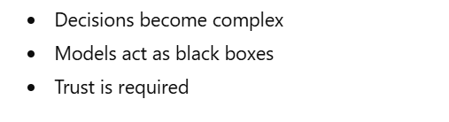
Why Explainable AI Is Needed
Notes:
Note to SMEs: Start the session with a recall of the concepts taught in core content would help build a connection between the two
For example, if teaching a session on e-skills, asking the learners what they understood from the first module or the core concepts that were taught in module

Slide 15
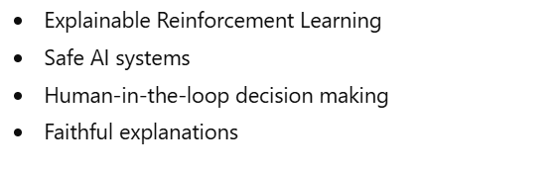
Research & Industry Focus (2024–2026)
Notes:
Note to SMEs: Start the session with a recall of the concepts taught in core content would help build a connection between the two
For example, if teaching a session on e-skills, asking the learners what they understood from the first module or the core concepts that were taught in module

Slide 16
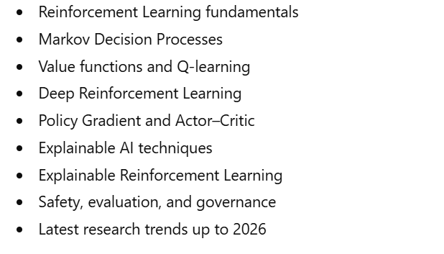
What We Will Cover Today
Notes:
Note to SMEs: Start the session with a recall of the concepts taught in core content would help build a connection between the two
For example, if teaching a session on e-skills, asking the learners what they understood from the first module or the core concepts that were taught in module

Slide 17

What Comes Next
Notes:
Note to SMEs: Start the session with a recall of the concepts taught in core content would help build a connection between the two
For example, if teaching a session on e-skills, asking the learners what they understood from the first module or the core concepts that were taught in module

Slide 18
Markov Decision Process (MDP) — Making Decisions Structured

Slide 19

Why We Need Structure in Reinforcement Learning

Slide 20
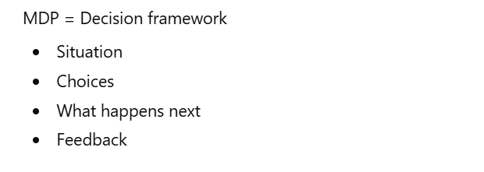
What Is a Markov Decision Process?

Slide 21
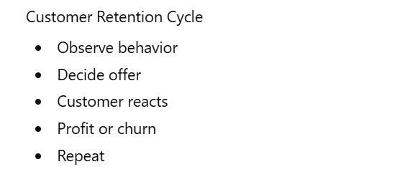
Corporate Example You Can Visualize

Slide 22
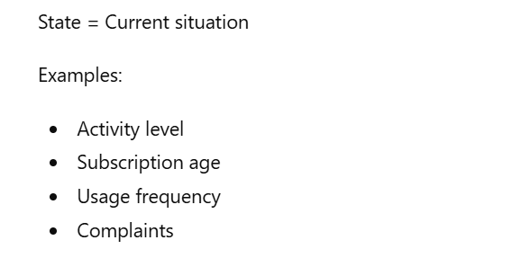
State — Where Am I Right Now?

Slide 23
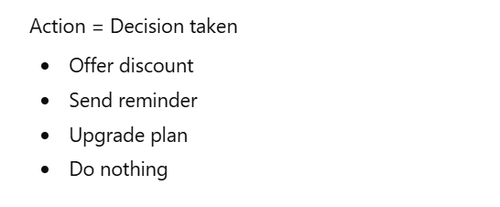
Action — What Can I Do?

Slide 24
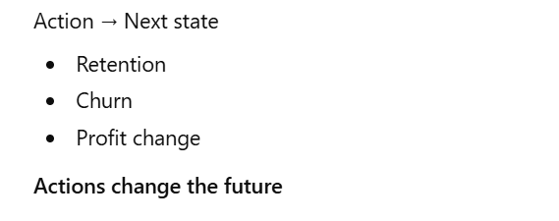
Transition — What Happens Next?

Slide 25
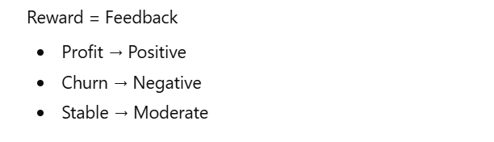
Reward — Was the Decision Good or Bad?

Slide 26
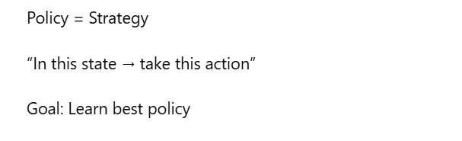
Policy — The Decision Strategy

Slide 27

The Markov Property (Very Important)

Slide 28
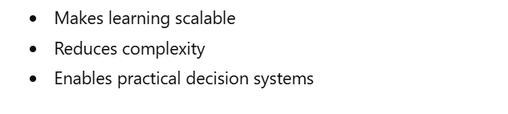
Why This Assumption Matters

Slide 29
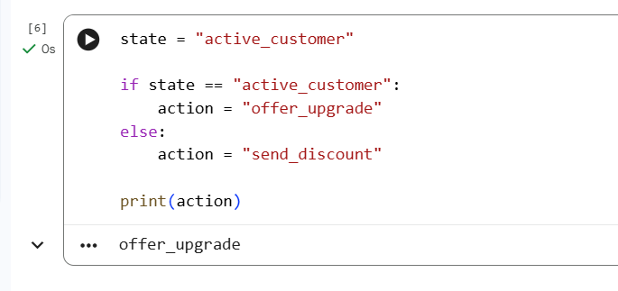

Tiny Code to Lock the Idea—MDP (GitHub)

Slide 30
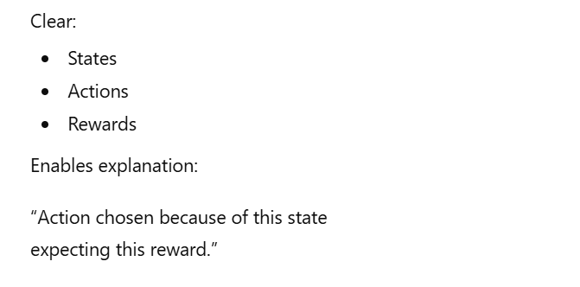
Why MDP Is Important for Explainable AI

Slide 31
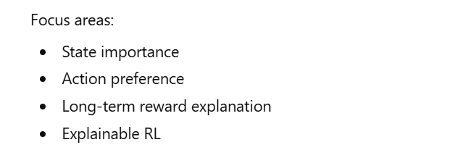
Modern Research Insight (2025–2026)

Slide 32
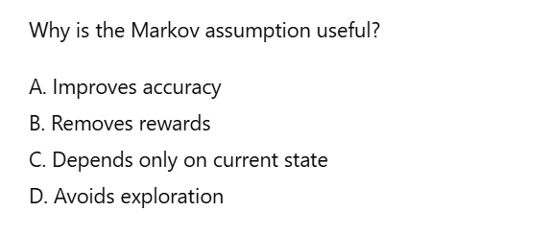
Quick Engagement Check-MCQ 2

Slide 33
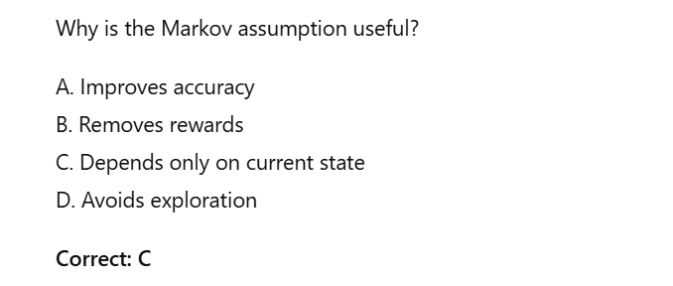
Quick Engagement Check-MCQ 2 Answer

Slide 34
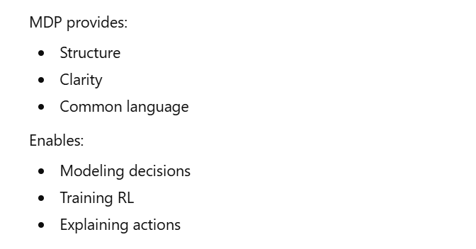
Summary of This Section

Slide 35
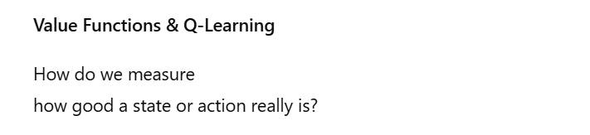
What Comes Next

Slide 36
Value Functions & Q-Learning — How RL Learns What Is “Good”

Slide 37
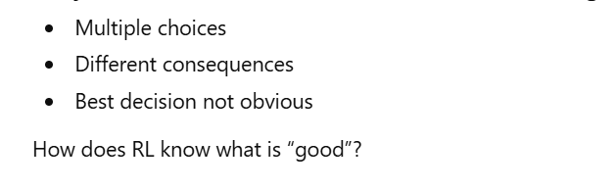
Why We Need Value in Reinforcement Learning?

Slide 38
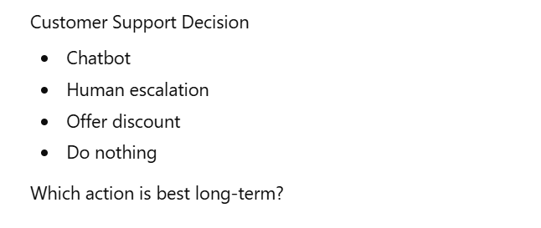
A Corporate Example Everyone Understands

Slide 39
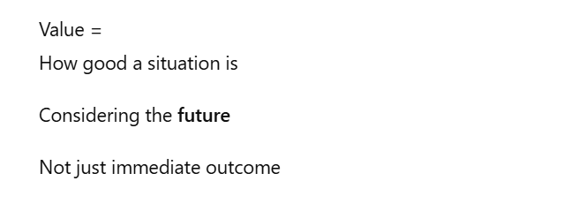
What Is Value? (Simplest Meaning)

Slide 40
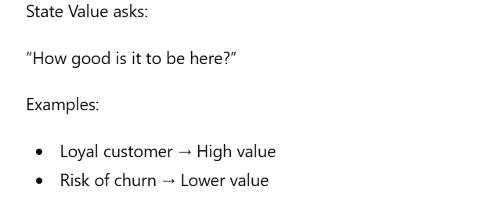
State Value — How Good Is This Situation?

Slide 41
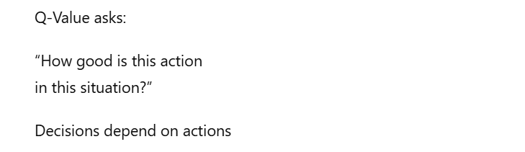
Action Value (Q-Value) — How Good Is This Action?

Slide 42

Why Q-Learning Is So Popular

Slide 43
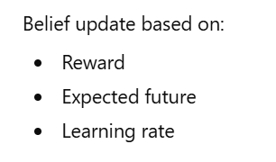
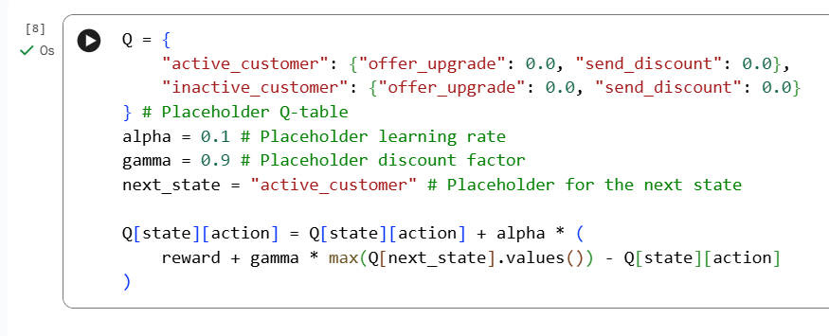
Simple Q-Learning Update

Slide 44

Why Learning Takes Time

Slide 45
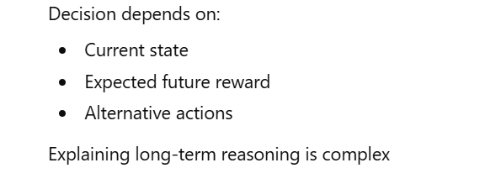
Why This Is Hard to Explain

Slide 46
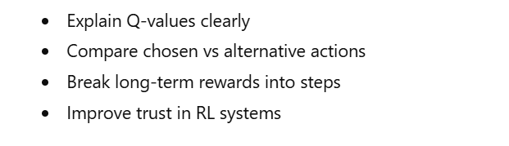
What Research Is Doing (2025–2026)

Slide 47
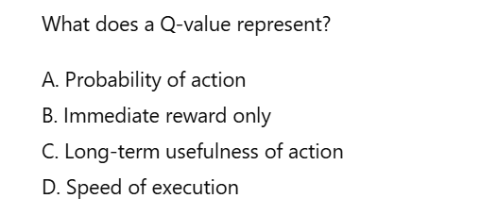
Quick Engagement MCQ 3

Slide 48
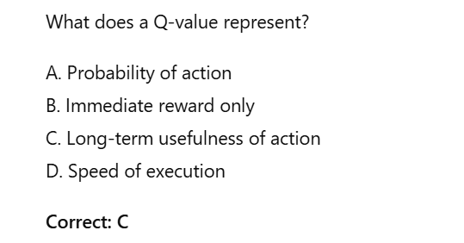
Quick Engagement MCQ 3 Answer

Slide 49
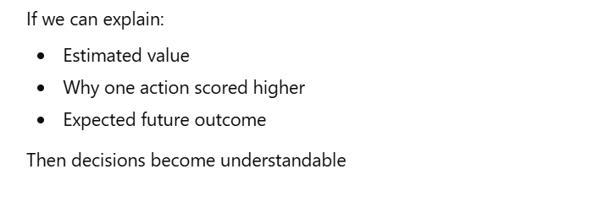
Why Value & Q-Learning Matter for Explainability

Slide 50
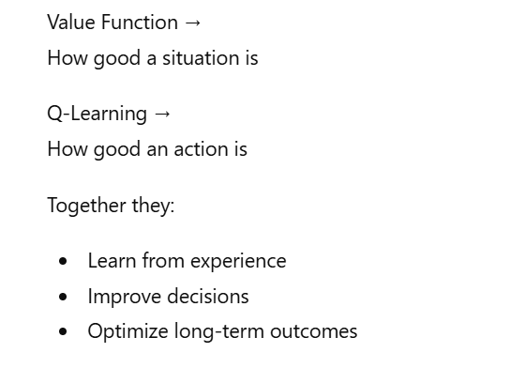
Summary of This Section

Slide 51
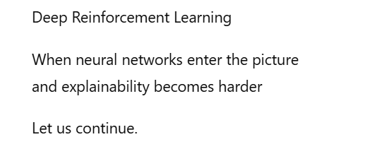
What Comes Next

Slide 52
Deep Q-Networks (DQN) — When RL Meets Deep Learning

Slide 53
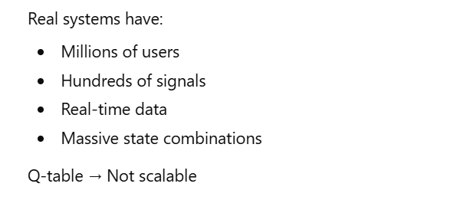
Why Q-Learning Is Not Enough in Real World?

Slide 54
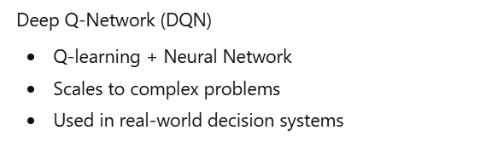
This Is Where Deep Learning Enters

Slide 55
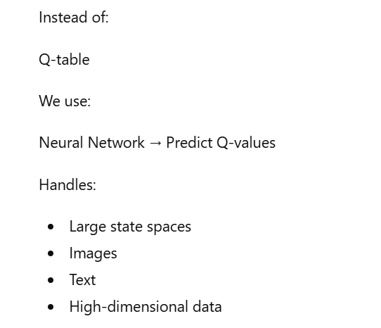
What Is a Deep Q-Network?

Slide 56
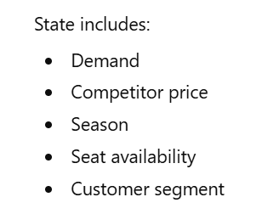
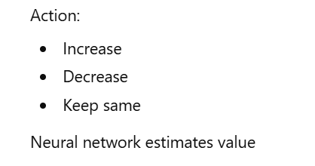
Corporate Example — Dynamic Pricing

Slide 57
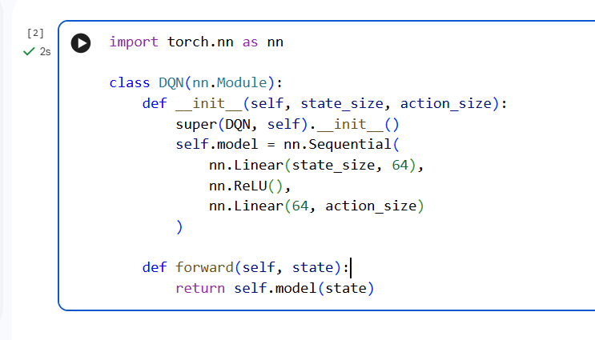
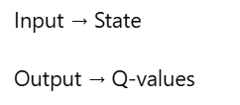
Conceptual Code Example (GitHub)

Slide 58
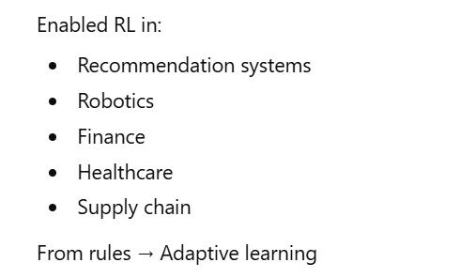
Why This Changed Industry

Slide 59
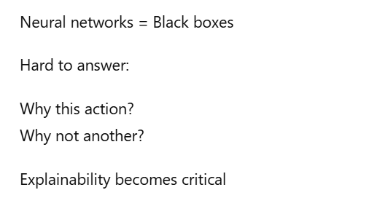
But Here Is the Big Problem

Slide 60
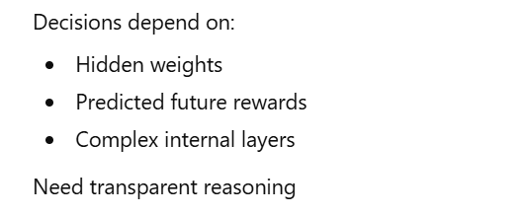
Explainability Challenge in Deep RL

Slide 61
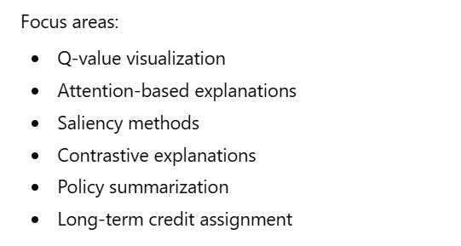
Recent Research Direction (2024–2026)

Slide 62

Engagement Reflection

Slide 63

Why This Section Is Important for You

Slide 64


Key Takeaway Before We Move Forward

Slide 65

What Comes Next

Slide 66
Actor–Critic & Modern Reinforcement Learning (Simple & Practical)

Slide 67

Why We Need More Than DQN?

Slide 68

Why We Need More Than DQN?

Slide 69

Actor–Critic in the Simplest Words

Slide 70

Corporate Example Everyone Understands

Slide 71

Why Actor–Critic Is Powerful

Slide 72


Tiny Code Idea (GitHub)

Slide 73

From Actor–Critic to Modern RL (PPO)

Slide 74

What Is PPO (Simplest Meaning)

Slide 75


Why PPO Is Used in Practice

Slide 76

Explainability Challenge Here

Slide 77

Corporate Business Reality

Slide 78

Key Research Direction (2024–2026)

Slide 79

Quick Engagement Reflection

Slide 80

Summary of This Section

Slide 81

What Comes Next

Slide 82
Explainable AI (XAI) for Reinforcement Learning — Making AI Decisions Understandable

Slide 83

Why Explainability Is No Longer Optional

Slide 84

Why RL Is Harder to Explain Than Normal ML

Slide 85

Three Simple Ways to Explain RL

Slide 86

Feature Importance

Slide 87

Counterfactual Explanation

Slide 88

Policy Summary

Slide 89

Corporate Case Study — Supply Chain Optimization

Slide 90

Where Research Is Moving (2024–2026)

Slide 91


Simple Conceptual Code for Explanation

Slide 92

Important Reality for Corporate Professionals

Slide 93

Short Engagement Question

Slide 94

Key Takeaway of This Section

Slide 95

What Comes Next

Slide 96
Safe Reinforcement Learning & Human-in-the-Loop Systems

Slide 97

Safe Reinforcement Learning & Human-in-the-Loop Systems

Slide 98

What Is Safe Reinforcement Learning?

Slide 99

Corporate Example — Energy Grid Control

Slide 100



How Safety Is Implemented (Simple View)

Slide 101

Why Safety Improves Explainability

Slide 102

Human-in-the-Loop Systems

Slide 103

What Does That Mean?

Slide 104

AI with Human Feedback

Slide 105


Why This Matters for 2026

Slide 106

Real Business Reality

Slide 107

Engagement Reflection

Slide 108


Key Takeaways of This Section

Slide 109

What Comes Next

Slide 110
Evaluation of Reinforcement Learning & Explainable AI

Slide 111

Why Evaluation Is Often Ignored — and Why That Is a Mistake

Slide 112

Evaluation in Reinforcement Learning (Simple View)

Slide 113

Corporate Example — Customer Retention System

Slide 114

Now Let Us Talk About Explainable AI Evaluation

Slide 115

Three Questions to Evaluate Explanations

Slide 116


Simple Example of Explanation Evaluation

Slide 117

Why This Matters in Real Companies

Slide 118

Modern Research Direction (2024–2026)

Slide 119


Explainability vs Performance Trade-off

Slide 120

Quick Engagement MCQ 4

Slide 121

Quick Engagement MCQ 4 Answer

Slide 122

Key Takeaways of This Section

Slide 123

What Comes Next

Slide 124
From Models to Real Systems — Deployment, Governance & Future Readiness

Slide 125

Why Real AI Is More Than Algorithms

Slide 126

What a Real RL + XAI System Looks Like

Slide 127

Corporate Example (Bank Use Case)

Slide 128


Why Monitoring Is Critical

Slide 129



Governance & Regulation (2026 Reality)

Slide 130

Why Documentation Matters

Slide 131

Where Research Is Headed (2025–2026)

Slide 132

Why This Matters for Master’s Students

Slide 133

Reflection Question

Slide 134

Key Takeaways

Slide 135

What’s Next?

Slide 136
From Revision to Research Thinking — How to Use What You Learned

Slide 137

Why Revision Alone Is Not Enough

Slide 138

How Researchers Look at RL and XAI

Slide 139

Identifying Research Gaps (Very Simple)

Slide 140

Corporate Example (Customer Retention)

Slide 141

Thinking in Variables

Slide 142

Importance of Baselines

Slide 143

Evaluation Defines Research Quality

Slide 144

Explainability: Research Goldmine

Slide 145

How to Read Research Papers

Slide 146

Advantage of Corporate Professionals

Slide 147

Key Mindset Shift

Slide 148

Reflection Question

Slide 149

What Comes Next

Slide 150
Putting Everything Together — How RL + XAI Actually Work in Practice

Slide 151

Let Us Pause and Connect the Dots

Slide 152

A Simple End-to-End Story

Slide 153

Step 1: Defining the Problem

Slide 154

Step 2: Learning From Interaction

Slide 155

Step 3: Scaling With Deep Learning

Slide 156

Step 4: The Trust Problem

Slide 157

Step 5: Adding Explainable AI

Slide 158

Step 6: Safety & Human Oversight

Slide 159


Step 7: Monitoring & Evaluation

Slide 160

Why End-to-End View Matters

Slide 161

Why This Matters in Exams

Slide 162

Why This Matters in Research

Slide 163

Quick Retention Check

Slide 164

Quick Retention Check (Answer)

Slide 165

Key Takeaway

Slide 166

What Comes Next

Slide 167
Open Research Directions in RL & XAI (2026 Focus)

Slide 168

Why Open Problems Matter

Slide 169

Open Problem 1

Slide 170

Open Problem 2

Slide 171

Open Problem 3

Slide 172

Open Problem 4

Slide 173

Open Problem 5

Slide 174

From Implementation to Investigation

Slide 175

How to Frame a Strong Research Problem

Slide 176

Corporate + Research Connection

Slide 177

Why This Matters for Career

Slide 178

Reflection Question

Slide 179

Reflection Question (Answer)

Slide 180


Key Takeaway

Slide 181


What Comes Next

Slide 182
Clearing Confusions & Locking Core Understanding (RL + XAI)

Slide 183

Why This Section Is Important

Slide 184


Confusion #1 — RL vs Supervised Learning

Slide 185


Confusion #2 — Reward vs Value

Slide 186


Confusion #3 — Q-Learning vs Policy Learning

Slide 187


Confusion #4 — Why Explainability Is Needed

Slide 188

Simple End-to-End Mental Model

Slide 189

Explain RL + XAI in One Minute

Slide 190

Exam & Interview Clarity

Slide 191

Real-World Reality Check

Slide 192

Reflection

Slide 193

Key Takeaways

Slide 194

What Comes Next

Slide 195
If You Remember Only This Much — RL & XAI Made Clear

Slide 196

Why This Section Is Important

Slide 197

One Simple Story That Explains Everything

Slide 198

What Reinforcement Learning Really Solves

Slide 199

Where Explainable AI Fits Naturally

Slide 200


Why RL and XAI Must Work Together

Slide 201

The One Mental Model to Keep

Slide 202

How to Explain RL + XAI to Anyone

Slide 203

Addressing a Common Feeling

Slide 204


What Real Systems Actually Need

Slide 205

Quick Reflection

Slide 206

What You Have Gained So Far

Slide 207

Where We Go Next

Slide 208
Complete Picture — Reinforcement Learning & Explainable AI

Slide 209

Let Us Bring Everything Together

Slide 210

What Reinforcement Learning Is Really About

Slide 211

Why Time and Consequences Matter

Slide 212

How Structure Makes Learning Possible

Slide 213

Why Deep Learning Was Needed

Slide 214

The Trust Problem

Slide 215

Where Explainable AI Fits Perfectly

Slide 216

Why Explainability Is Not Optional

Slide 217

Why Safety and Human Oversight Matter

Slide 218

How Evaluation Holds Everything Together

Slide 219

One Simple End-to-End View

Slide 220

What You Should Be Able to Say Confidently

Slide 221

Why This Understanding Matters

Slide 222

Final Reflection

Slide 223

Where We Stop and What Stays With You

Slide 224
AI Impact Summit 2026 – RL & Explainable AI Projects

Slide 225

1️⃣ REC Limited – Smart Energy Trading

Slide 226

2️⃣ Wipro – Trusted & Explainable AI

Slide 227

3️⃣ SatSure – AI for Agriculture Intelligence

Slide 228

4️⃣ Intello Labs – AI-Based Crop Grading

Slide 229

5️⃣ Wysa – Adaptive AI in Mental Health

Slide 230

Strong Closing

Slide 231
Thank You!

